Slide 1



Strat. Consultancy Project I & Data Analytics
MT5125 | MSc in Business Administration | 2020/2021
Dr. Damien Dupré
damien.dupre@dcu.ie
Assistant Professor - Business Research Methods

Slide 2
2. Data Cleaning and Transformations

Slide 3
Data Cleaning

Slide 4
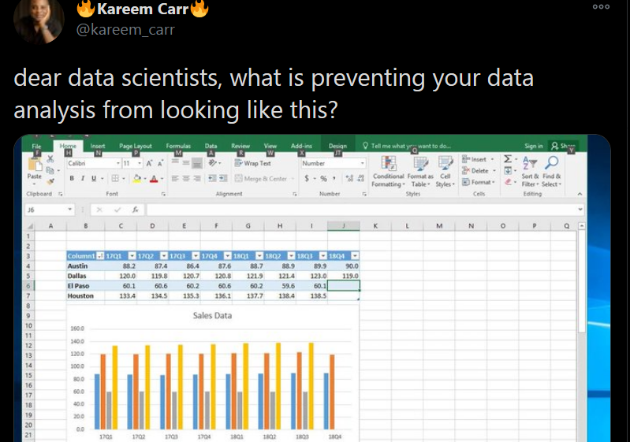
Question from Kareem

Slide 5
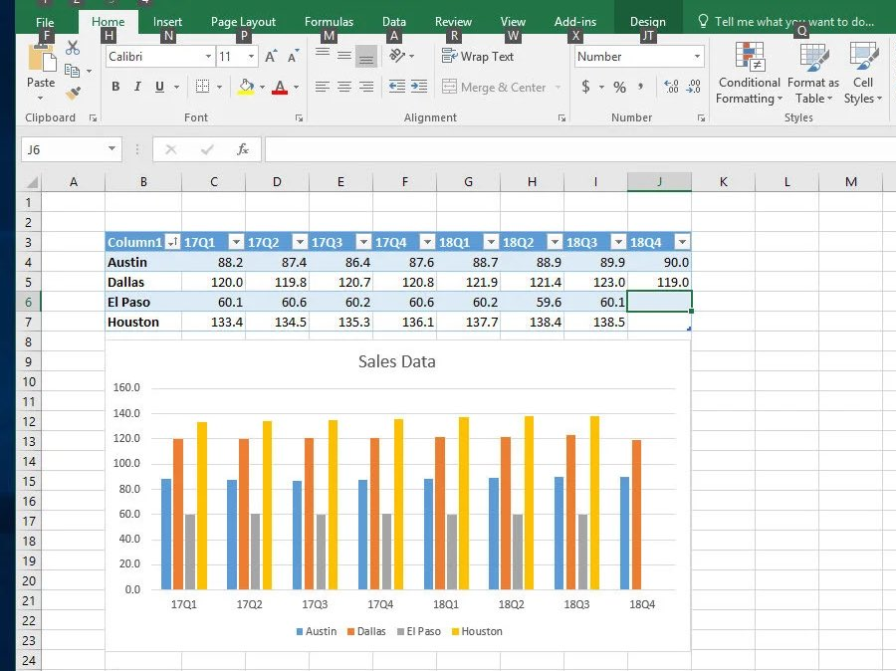

Slide 6

Answer from Michael

Slide 7
Clean a data table
Ditch the chart and all non values
Charts can mess up with other software
Save as .csv file
Better format and keeps only the current sheet
Column headings in row 1
No more than 1 heading row and remove blanks
Columns start at column A
Remove blanks before data
Any other spreadsheet is chaotic evil!

Slide 8
Exercise: Clean UNICEF.XLSX

Slide 9
Clean unicef.xlsx
On the MT5125 Loop page, download and open the document “unicef.xlsx” located in:
Data Analytics Supplementary Information> Lecture 2
Clean this data file

Slide 10
Transform DATA

Slide 11
Master the Key Movements
Most important work is to tidy your data
Takes time to saves time and solves problems
5 movements are necessary to master (almost)

Slide 12

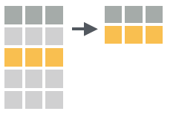
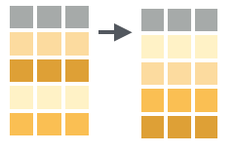
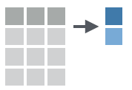
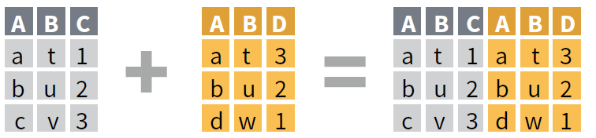
Master the Key Movements
Extension
Reduction
Direction
Aggregation
Combination

Slide 13
EXTENSION

Slide 14
Extension with MS Excel
Extension = New Column
In MS Excel:
First row is row name (name convention)
Second row is the function (starts with =)
Following rows are applied (squared corner)

Slide 15
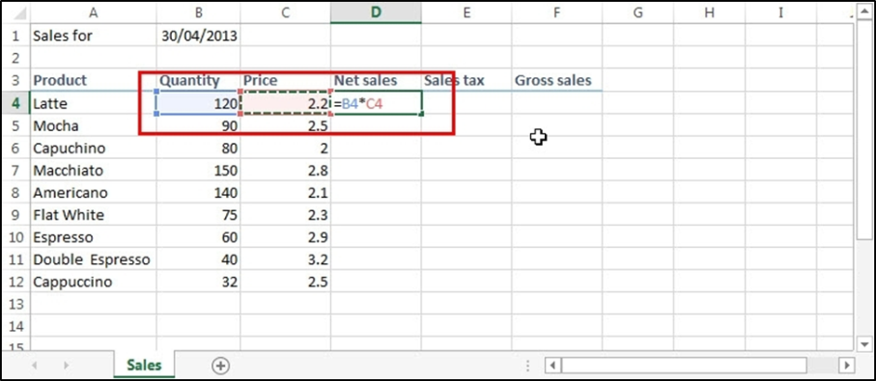
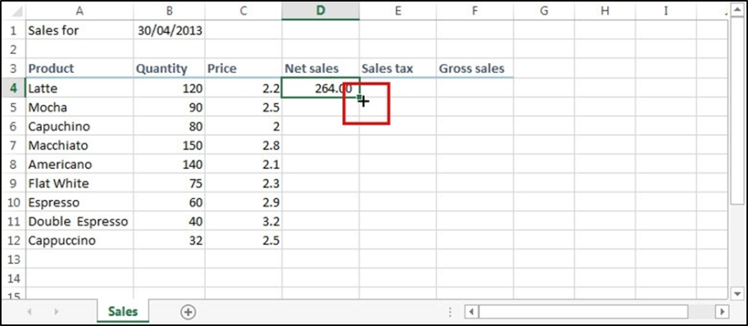
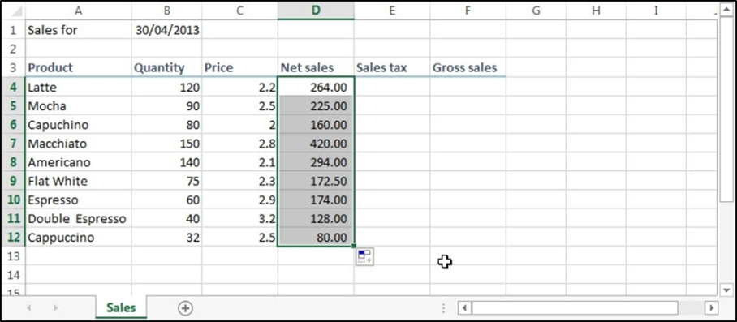
Extension with MS Excel
1
2
3

Slide 16
Excel Functions
For numeric values
Numeric operator ( + - / *)
$ (fixed parameter)
COUNT(), MIN(), MAX(), SUM(), AVERAGE (), STDEV()
For character strings
LEFT()
CONCATENATE()
Extra function
IF(condition, value if true, value if false)

Slide 17
Reduction

Slide 18
Reduction with MS Excel
Reduction = Filter Column
In MS Excel:
Select header row
In Data tab, use Filter
Click the drop-down arrow for the column you want to filter
Choose values to filter

Slide 19
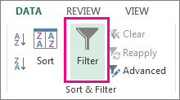
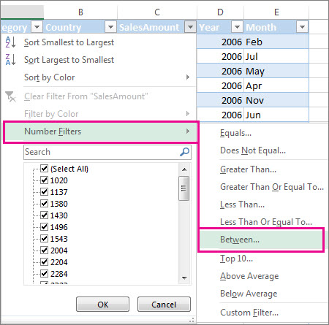
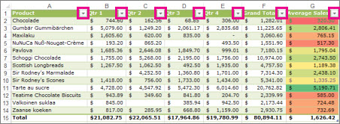
Reduction with MS Excel
4
2
3

Slide 20
Reduction with MS Excel
Rows already filtered have a row index are coloured in blue
Copy-Paste filtered table in a new document if you want to work only on these values
More about Excel filters:
https://edu.gcfglobal.org/en/excel2010/filtering-data/1/
https://support.office.com/en-ie/article/filter-data-in-a-range-or-table-01832226-31b5-4568-8806-38c37dcc180e

Slide 21
Direction

Slide 22
Direction with MS Excel
Direction = Arrange Row Order
In MS Excel:
Select table
In Data tab, use Sort
Choose column to sort and how to sort

Slide 23
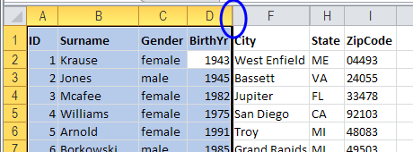
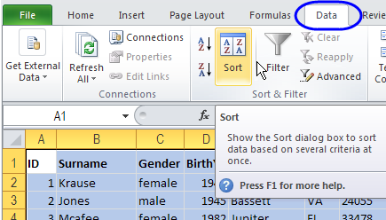
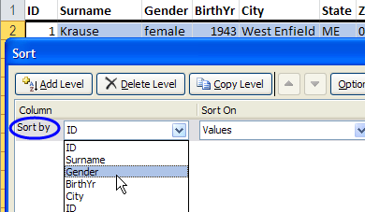
Direction with MS Excel
1
2
3

Slide 24
Direction with MS Excel
Be careful of taking into account all the table
All rows
All columns
Double check if all columns changed
More about Excel sorting:
https://www.contextures.com/xlSort01.html
https://support.office.com/en-ie/article/sort-data-in-a-range-or-table-62d0b95d-2a90-4610-a6ae-2e545c4a4654

Slide 25
Aggregation

Slide 26
Aggregation with MS Excel
Aggregation = Summary of Column
In MS Excel:
Simple = use function at the end of a table
Complex = use pivot table

Slide 27
Simple Aggregation
Function | Calculation
=COUNT(A1:A10) | Total number of values
=MIN(A1:A10) | Minimum value
=MAX(A1:A10) | Maximum value
=SUM(A1:A10) | Sum of all values
=AVERAGE (A1:A10) | Sum of all values divided by total number
=STDEV(A1:A10) | Average distance of values to the average

Slide 28
Complex Aggregation
Pivot Table
Select data
In Insert, use Pivot Table
Drag columns to sort by row/column
Choose value column to be aggregated
Choose type of aggregation

Slide 29
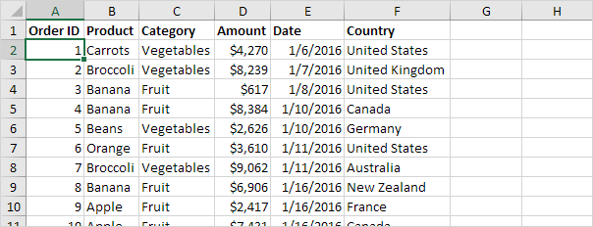
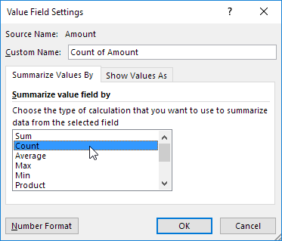
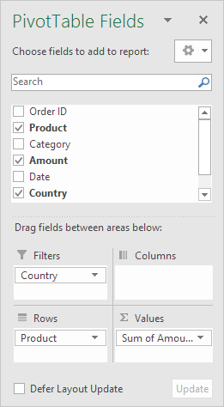
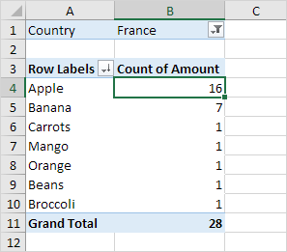

Complex Aggregation
1
4
3
2

Slide 30
Complex Aggregation
If you want to use the Pivot Table for further analysis
Copy-Paste it in another document
Paste as value (removes dynamic link)
More about Excel pivot table:
https://www.excel-easy.com/data-analysis/pivot-tables.html
https://support.office.com/en-us/article/create-a-pivottable-to-analyze-worksheet-data-a9a84538-bfe9-40a9-a8e9-f99134456576

Slide 31
Combination

Slide 32
Combination with MS Excel
Combination = Join two tables
In MS Excel:
One Column = vlookup function
Multiple Columns = Power Query (Windows only)

Slide 33
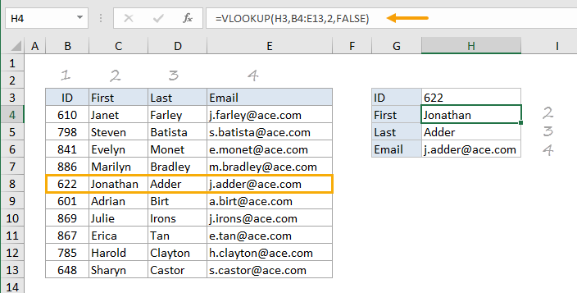
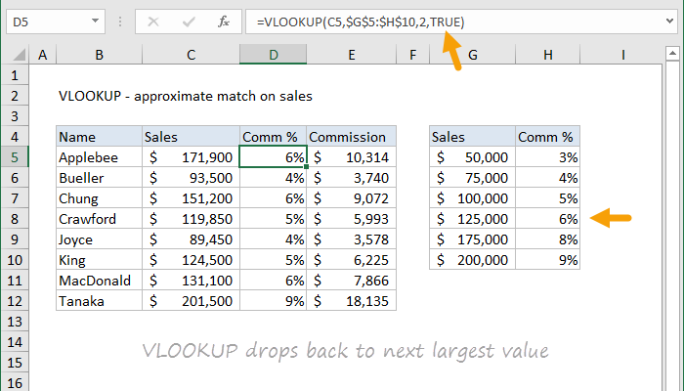
One Column Combination
=VLOOKUP(value, table, col_index, [range_lookup])
value - The value to look for in the first column of a table
table - The table from which to retrieve a value
col_index - The column in the table from which to retrieve a value
range_lookup - [optional] TRUE = approximate match (default). FALSE = exact match
One Cell Example: One Column Example:
=VLOOKUP(H4,B5:E9,2,FALSE)
=VLOOKUP(C5,$G$5:$H$10,2,TRUE)

Slide 34
Multiple Columns Combination
MS Excel Power Query (Windows Only)
Add-on in Excel 2010-2013
Built-in in Excel 2016-2019
Requirements
Tables to combine have to be saved in a document
Combine in a new document

Slide 35
Multiple Columns Combination
MS Excel Power Query, in Data tab:
File 1:
Get Data/New Query> From File > From [Workbook/CSV]
Select your first file and the corresponding sheet > Load
File 2:
Get Data/New Query> From File > From [Workbook/CSV]
Select your second file and the corresponding sheet > Load
Get Data/New Query > Combine Queries > Merge
Identify the tables to merge/append and select the column to use
Click Columns to Expend
Untick “Use original column name as prefix”
OK > Close and Load

Slide 36
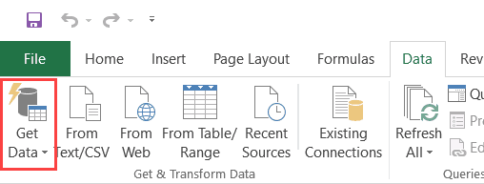
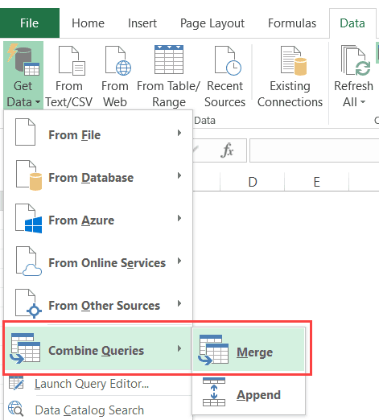
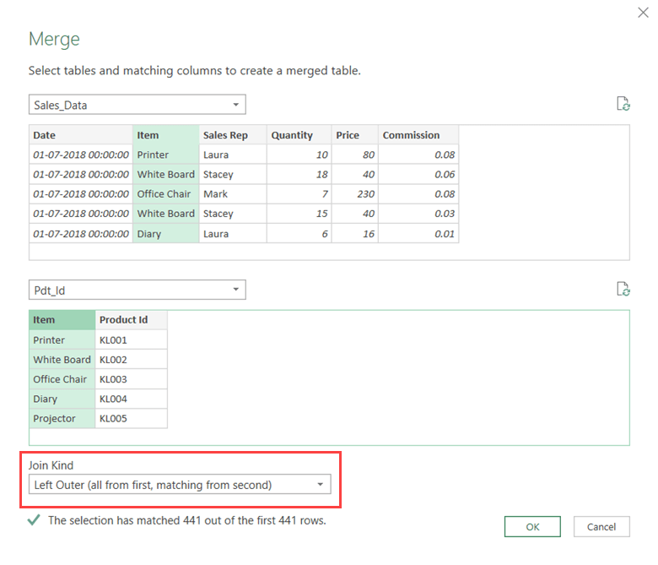
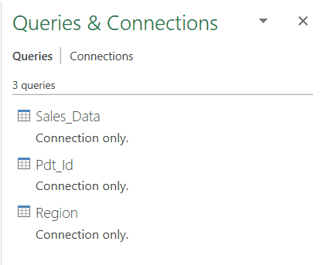
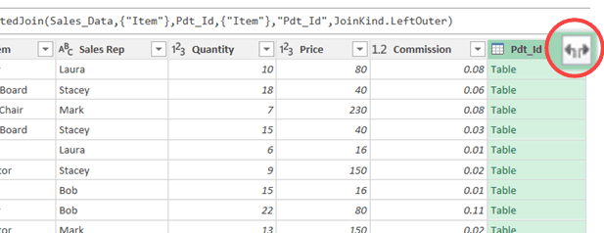
Multiple Columns Combination
1
3
4
2
5

Slide 37
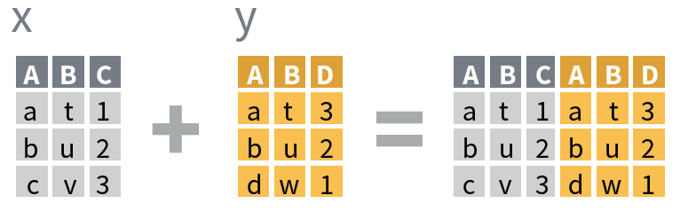
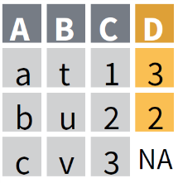
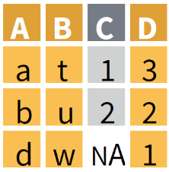
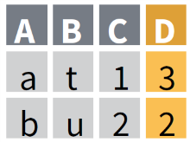
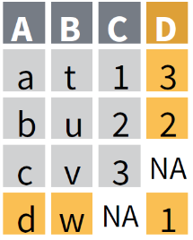
Types of Combination
Left Join
Right Join
Inner Join
Full Join

Slide 38
Exercise: transformations

Slide 39
Exercise: Transformations
On the MT5125 Loop page, download and open the document “employee_d&d_excerpt.xls” located in:
Data Analytics Supplementary Information> Lecture 2
Extension: Create a new variable/column which is the average response to all the questions from the survey for each employee (q1 to q9)

Slide 40
Exercise: Transformations
Reduction: Filter employee’s 2019 salary to keep only employees with a salary higher than 30k
Aggregation: Calculate the average salary by gender and by location
Combination: Using the VLOOKUP function, add to the table a column corresponding to the 2017 salary located in the 2nd sheet

Slide 41
Extra ANALYTIC TIP

Slide 42

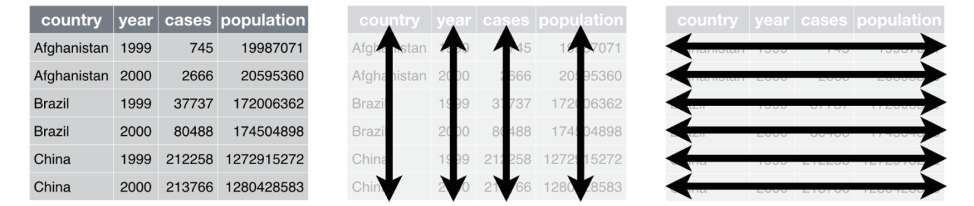
Tidy Data
Database
Each variable has its own column
Each observation is placed in its own row
Each value is placed in its own cell
Levels
1
Tables/Files
2
3
Records/Observations
4
Fields/Variables
5
Characters (bytes)

Slide 43
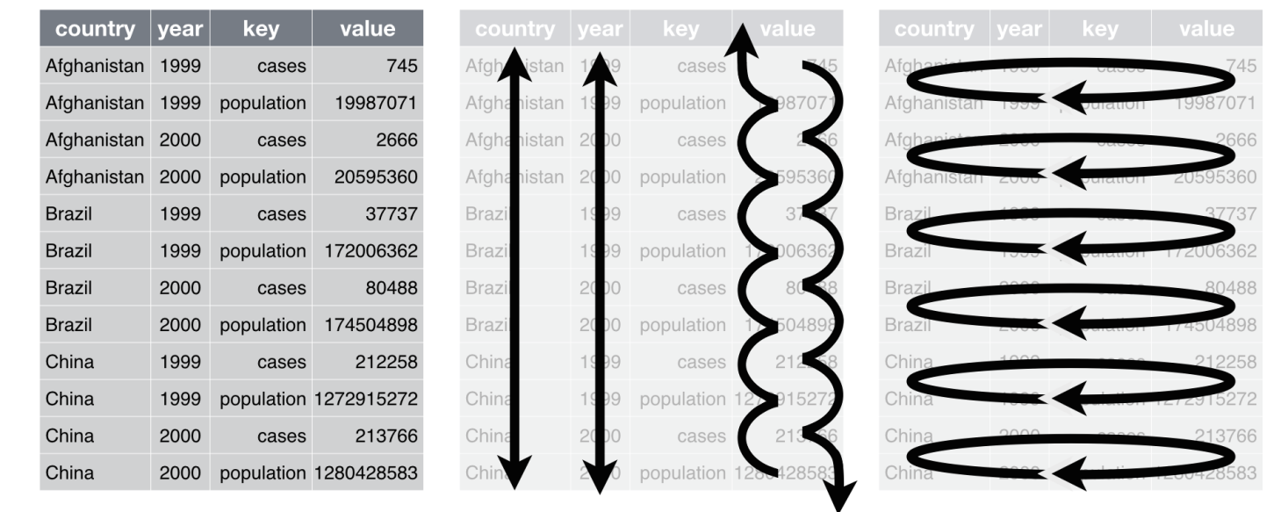
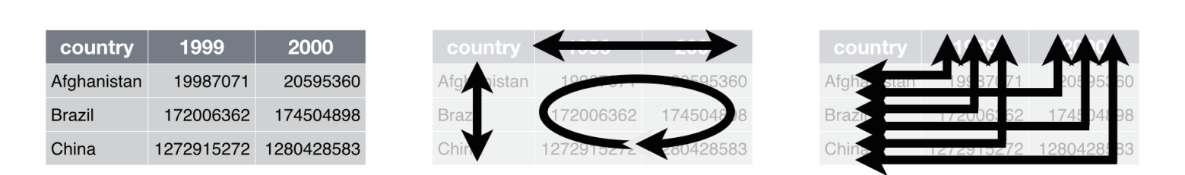
Long or Wide?
Long format
Wide format

Slide 44
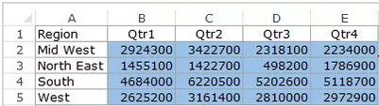
Long or Wide?
Which type is this table?

Slide 45
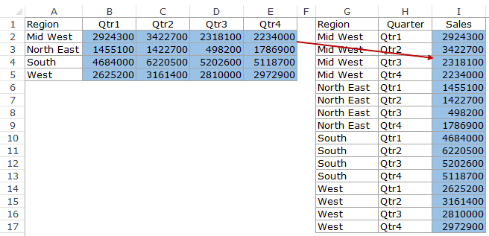
Long or Wide?

Slide 46
Reshape Table
In Data tab
Get Data/New Query> From File > From [Workbook/CSV]
Select your file > Edit
Select columns to be reshaped
Transform
Pivot Columns: from long table to wide table
Unpivot Columns: from wide to long table

Slide 47
Reshape Table
Example: from wide table to long table
See for more details:
https://trumpexcel.com/source-data-for-pivot-table/

Slide 48
MS Excel’s Macro
The Macro button allows to record a sequence of actions and to reproduce these actions
VBA Code automatically recorded
Useful to process similar data files

Slide 49
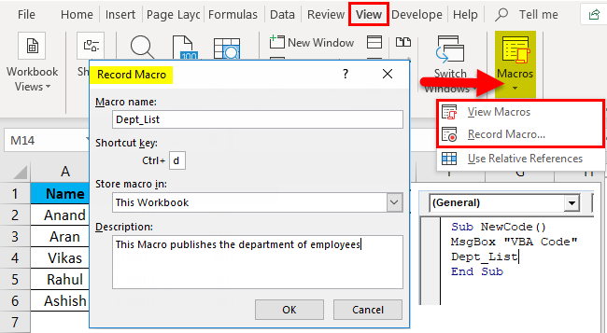
MS Excel’s Macro
In View tab
Use Macros > Record Macro
Do your actions
Save the macro with a keyboard shortcut
Use the macro again to reproduce your actions

Slide 50

Questions?

